Slide 1


GENERATIVE AI IN DEPTH
GENERATIVE AI Bootcamp
Usama wahab Khan
MVP,MCT, CTO @Evolution Technologies
Notes:
Introduce the team (self-introductions). Mention LearnAI – team.
3 day airlift, transition from pure databricks to AML
We will use notebooks to introduce tools and techniques, and then return to one use-case
We have three kinds of session: (1) presentation style, (2) demos (w/ small exercises), (3) hands-on labs.
Last day is a Hackathon (w/ two use cases)
Check people’s skills. Experience with Databricks, Jupyter notebooks, VS Code, Deep Learning. Who has heard of AMLCompute? Who has used it? Who has used CI/CD and git version control?

Slide 2






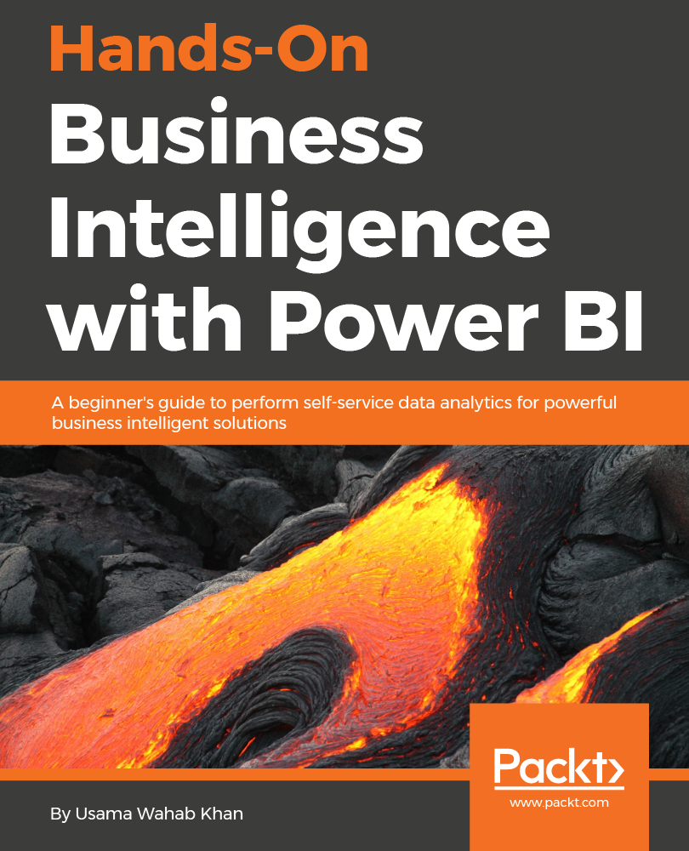





Usama Wahab Khan
Father, data Scientist, Developer/Nerd, Traveler
Twitter : @usamawahabkhan
LinkedIn : Usamawahabkhan

Slide 3
https://tinyurl.com/ailocaldxb

Slide 4
Day 1 — Learning Objectives
By the end of Day 1, participants will be able to:
1
Foundations
2
Reasoning techniques
Explain Agentic AI architecture
Differentiate Agents vs LLM pipelines
Understand Planner, Executor & Tool agents
Apply Chain of Thought (CoT)
Apply Tree of Thoughts (ToT)
3
Tools & models
4
Putting it together
Build custom tools
Use OpenRouter APIs
Integrate Qwen models
Implement function calling
Build a reasoning-enabled agent
Built with LangChain (ReAct loop)

Slide 5
Ollama
Install Ollama Download and install Ollama for macOS, Windows, or Linux from the official website.
Pull a model ollama pull qwen2.5:1.5b or ollama pull llama3.1:8b ollama pull mistral:7b
Run a model (chat mode) ollama run qwen2.5:1.5b
One-shot prompt ollama run qwen2.5:1.5b "Write a short poem about AI."
List installed models ollama list
Remove a model ollama rm qwen2.5:1.5b
Use Ollama with Python (OpenAI-compatible API) from openai import OpenAI Build it: ollama create mymodel -f Modelfile
Run it: ollama run mymodel
Ollama does not include tools or agents by itself. You can build agents using Python, LangChain, LangGraph, or FastAPI.
Summary: Pull a model, run it, and use it locally via CLI or API.

Slide 6
What is an AI Agent?
An AI agent is a software system that uses an AI model (typically a large language model) to autonomously pursue goals: it perceives its context, decides what to do, takes actions through tools, and loops on the results until the task is complete.
In short: the LLM is the brain; the agent adds hands, memory, and the ability to act on its own — instead of just telling you how to triage your inbox, an agent reads the emails, drafts replies, and schedules the meetings.
Goal-directed
Tool use
Reasoning
Memory
Autonomy loop
Pursues an objective, not step-by-step instructions
Calls APIs, searches, runs code, operates software
Breaks the goal into steps and orders them
Retains context across steps and sessions
Observes results and adapts until done

Slide 7
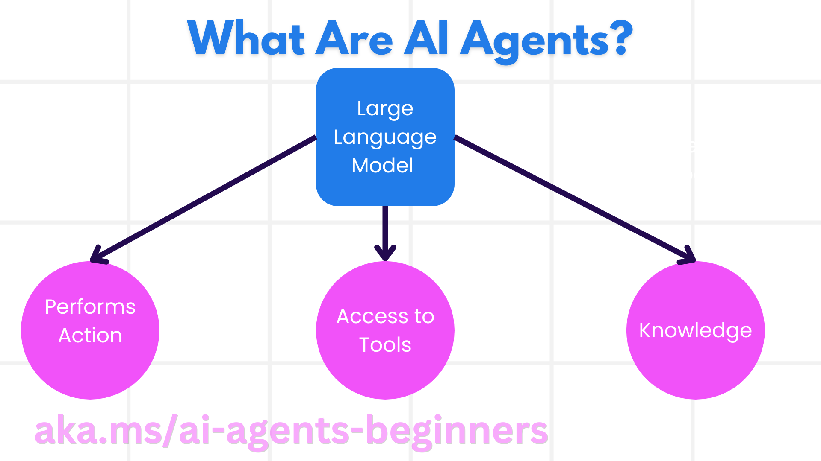

Slide 8
LLM for Agent
A reasoning‑instructional model is an LLM trained to both think and follow instructions. To be used as an agent, an LLM must support:
reliable tool calling
stable JSON
multi‑step reasoning
deterministic behavior
error recovery
long‑context
low hallucination
fast inference
memory integration
Notes:
https://huggingface.co/MaziyarPanahi/calme-3.2-instruct-78b
https://huggingface.co/spaces/open-llm-leaderboard/open_llm_leaderboard#/

Slide 9
What Is a Reasoning‑Instructional Model?
A reasoning‑instructional model is an LLM trained with two combined abilities:
Instruction following The model understands tasks, constraints, formats, and roles.
Reasoning The model performs multi‑step thinking, planning, and logical inference.
This combination makes the model suitable for agents, because agents need both:
obedience (follow instructions)
intelligence (reason through steps)
What makes a model “reasoning‑instructional”
CoT‑tuned (chain‑of‑thought training)
DPO/RLHF aligned for instruction following
Tool‑calling trained
JSON‑stability tuned
Long‑context optimized
Error‑recovery capable

Slide 10
example
Qwen2.5 | Best overall | Production agents
DeepSeek‑R1 | Best reasoning | Research agents
Llama 3.1 | Balanced | General agents
Mistral Large | Best tool use | Automation agents
Phi‑3.5 | Best small model | Edge agents

Slide 11
. Model Runtime Layer
You need a runtime that is faster, safer, and more controllable than Ollama for production:
vLLM (GPU‑optimized, high‑throughput)
TGI (Text Generation Inference)
LM Studio Server Mode (local API)
Custom FastAPI wrapper around GGUF models
These runtimes give you:
token streaming
batching
concurrency
memory control
production‑grade APIs
Ollama is great for development, not for high‑load production.

Slide 12
⚙️ Production‑Grade Local LLM Stack (A100 GPU)
1. vLLM Runtime
The best choice for A100. Why it’s production‑grade:
Continuous batching
Extremely high throughput
CUDA‑optimized for A100
Stable OpenAI‑compatible API
Perfect for agents + tool calling
Supports FP16, BF16, and quantized models
Use vLLM when you need speed + stability + scale.

Slide 13
2. TGI (Text Generation Inference)
A strong alternative for production:
Optimized for GPUs including A100
Very stable for long‑context models
Excellent for enterprise deployments
Supports tensor parallelism
Use TGI when you want enterprise‑grade reliability.

Slide 14
3. FastAPI + GGUF + CUDA Kernels
A custom lightweight server:
Good for small/medium models
Works with llama.cpp CUDA builds
Lower memory footprint
Easy to embed inside microservices
Use this when you want full control and simple deployment.

Slide 15
4. LM Studio Server Mode
Not enterprise, but useful for:
Desktop local API
Quick prototyping
Testing models before vLLM/TGI deployment

Slide 16
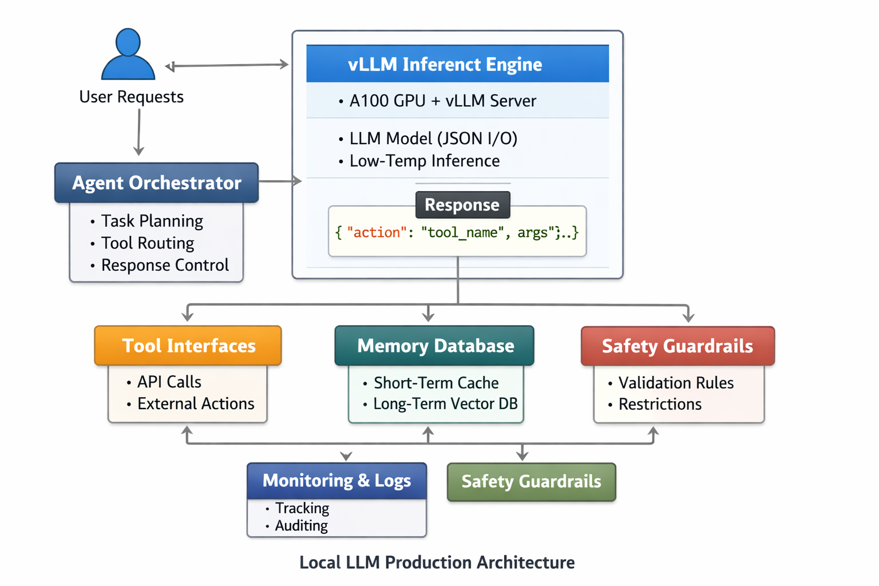

Slide 17
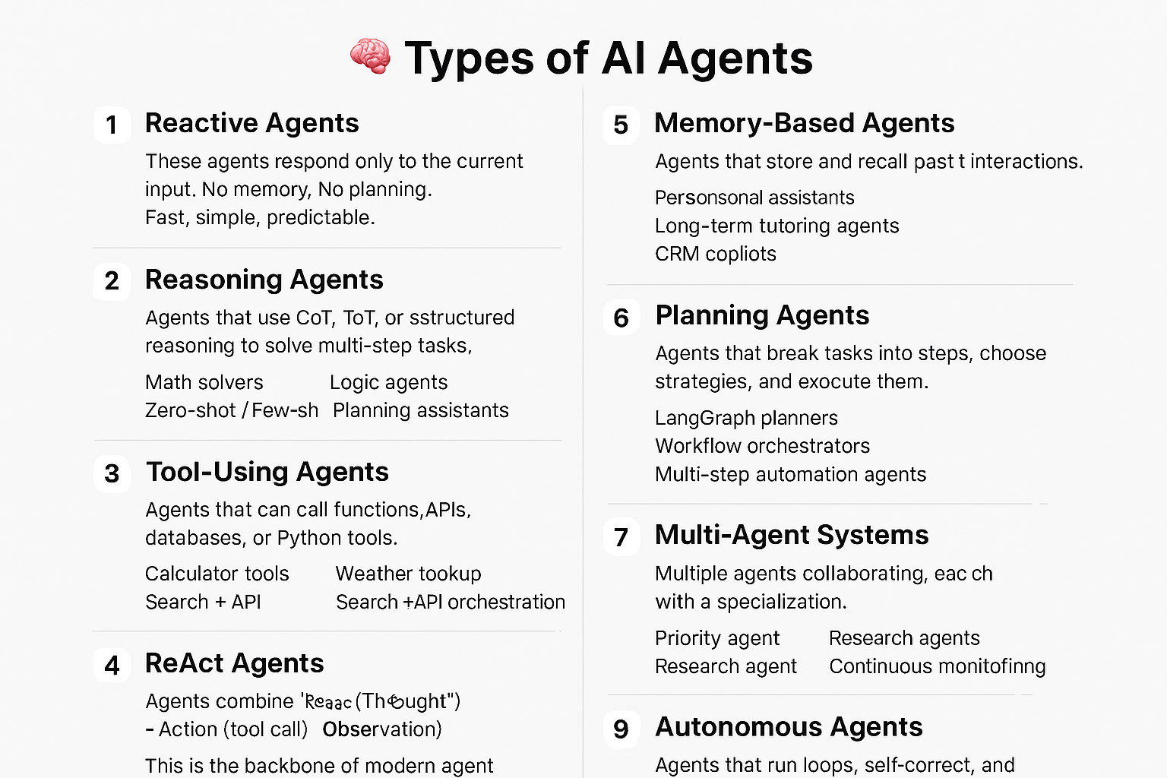
Notes:
Types of AI Agents
1. Reactive Agents
Respond only to the current input. No memory, no planning, no tool use. Fast and simple.
2. Reasoning Agents
Use structured reasoning such as Chain‑of‑Thought or Tree‑of‑Thought. Good for logic, math, and multi‑step tasks.
3. Tool‑Using Agents
Can call external tools such as functions, APIs, databases, or Python code. Useful for calculators, search, weather, or any real‑world action.
4. ReAct Agents
Combine reasoning and action: Thought → Action → Observation → Final Answer. This is the foundation of modern agent frameworks.
5. Memory‑Based Agents
Store and recall previous interactions. Useful for personal assistants, tutoring, or long‑term workflows.
6. Planning Agents
Break tasks into steps, choose strategies, and execute them. Often used in workflow automation and LangGraph‑style systems.
7. Multi‑Tool Agents
Can choose between multiple tools dynamically. Your example agent (add, multiply, weather) belongs here.
8. Multi‑Agent Systems
Multiple specialized agents collaborating. Used for research, coding, routing, and decision‑making.
9. Autonomous Agents
Run loops, self‑correct, and continue until a goal is reached. Similar to AutoGPT‑style behavior.

Slide 21
Key layers
Layer | Description
Perception | Collects data from environment or user input.
Reasoning | Uses logic or LLM inference to interpret context.
Planning | Breaks goals into actionable steps.
Execution | Performs tasks via APIs, tools, or actuators.
Feedback | Evaluates results and refines future actions.

Slide 22
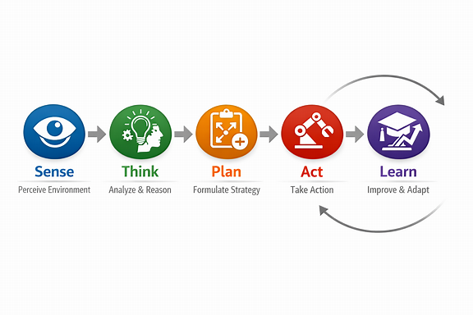

Slide 23
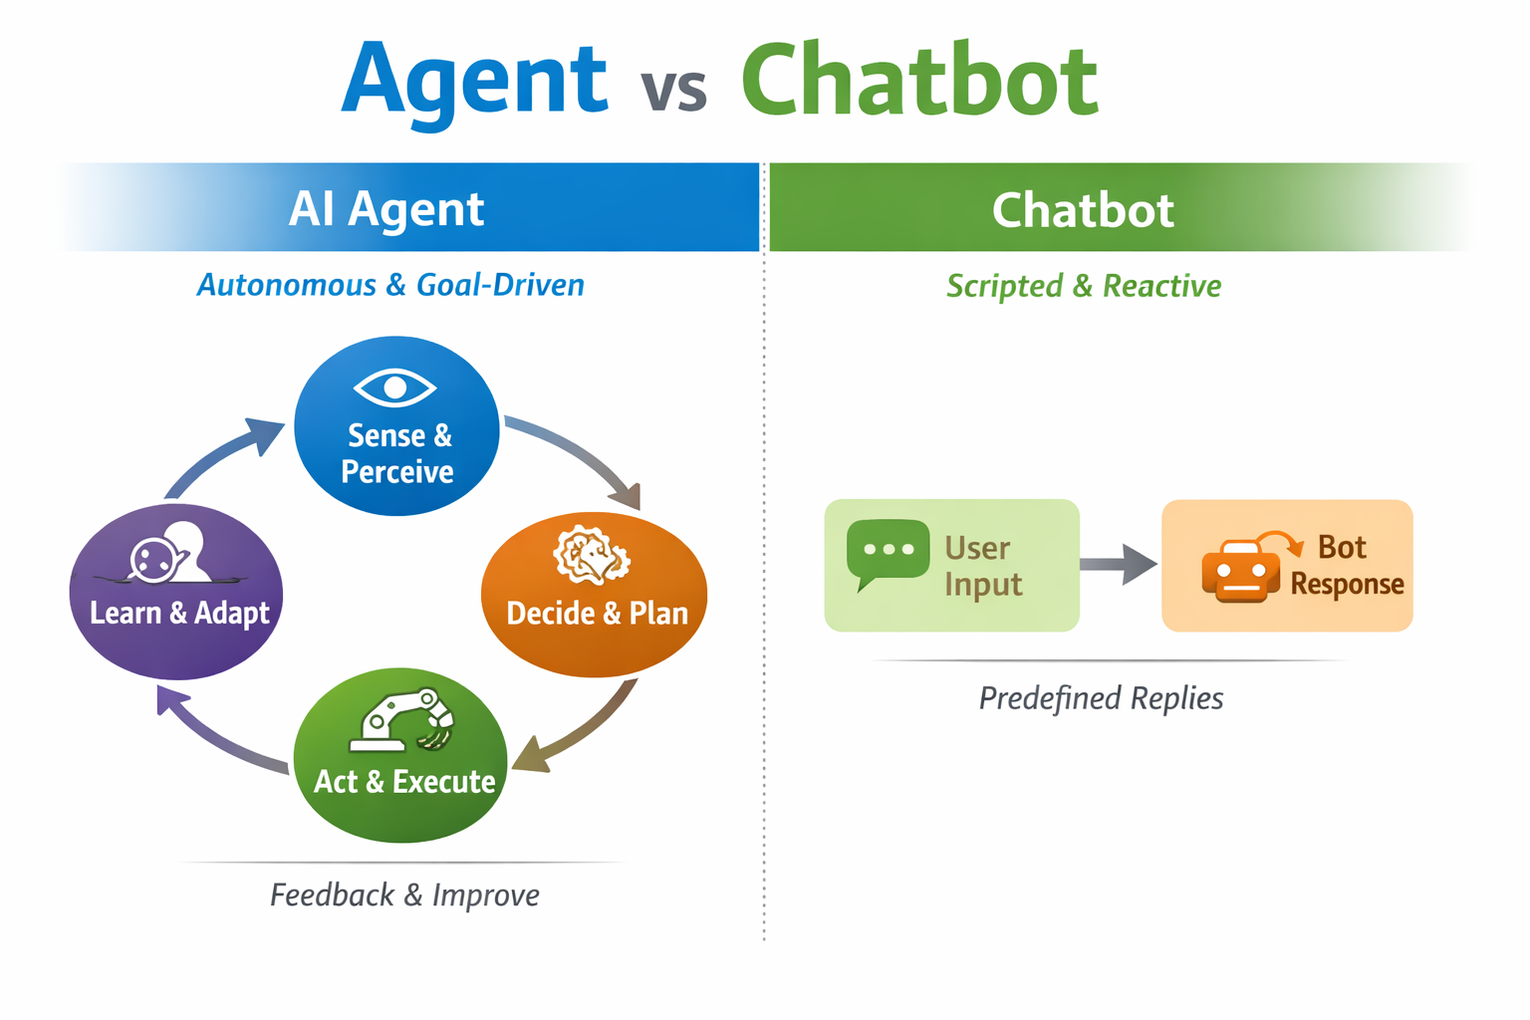

Slide 24
Agentic AI Architecture
An agent runs a continuous loop: it perceives input, plans with an LLM, acts through tools, observes the result, and repeats — drawing on memory throughout.
Agent Core — LLM Reasoning
Perceive
Plan
Act
Observe
loop until the goal is met
Memory · retains context across steps & sessions
Tools / Environment · APIs, code, web, data

Slide 25
Agents vs LLM Pipelines
LLM Pipeline
AI Agent
Fixed, predefined sequence of steps
Same path runs every time — no branching
No autonomous decisions; developer sets the flow
Single pass: input → prompt → output
Stateless between calls unless wired manually
Dynamic control flow chosen at runtime
Decides which steps and tools to use
Acts in a perceive–plan–act–observe loop
Calls tools, APIs and code to affect the world
Maintains memory and adapts to results
Bottom line: a pipeline follows a script; an agent decides what to do next.

Slide 26
Agents vs LLM Pipelines
Feature | AI Agent | LLM Pipeline
Autonomy | Self-directed | User-driven
Goal Handling | Multi-step reasoning | Single-turn inference
Memory | Persistent context | Stateless
Tool Use | Dynamic | Predefined
Learning | Continuous | Model-fixed

Slide 27
Planner, Executor & Tool Agents
A multi-agent system splits responsibility across specialized roles that hand work to one another.
Planner
Executor
Tool Agents
Breaks the goal into an ordered plan of sub-tasks. Reasons about what must happen and in what sequence. Re-plans when results change.
Carries out the plan step by step. Decides which tool to invoke for each step and passes the right inputs. Feeds results back to the planner.
Specialized workers: web search, code runner, database, calculator, file I/O. Each exposes a clear interface and returns a result.
results & observations flow back — the planner adapts
In a single-agent setup, one LLM plays all three roles in turn; in multi-agent systems they are separate, coordinating agents.

Slide 28
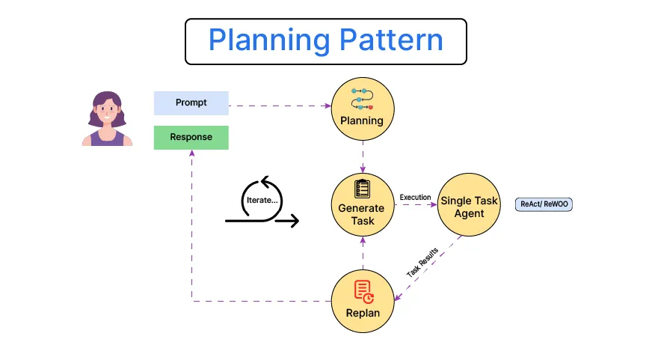
Planner, Executor, and Tool Agents
Roles
Planner Agent → Decomposes tasks into subtasks.
Executor Agent → Executes subtasks sequentially or in parallel.
Tool Agent → Interfaces with APIs, databases, or external systems.

Slide 29
Chain of Thought (CoT)
CoT prompts the model to reason step by step before answering — making intermediate reasoning explicit improves accuracy on multi-step problems.
How it works
Ask the model to “think step by step” before giving the final answer
Each step builds on the previous one in a single linear chain
Why it helps
Breaks hard problems into smaller, checkable steps
Improves accuracy on arithmetic, logic and multi-hop questions
When to use
Tasks needing reasoning, not just recall
When you want the reasoning to be auditable
Worked example
Q: A shop has 23 apples. It sells 8, then a delivery adds 15. How many now?
Step 1: Start with 23 apples.
Step 2: Sell 8 → 23 − 8 = 15.
Step 3: Delivery adds 15 → 15 + 15 = 30.
Answer: 30 apples.

Slide 30
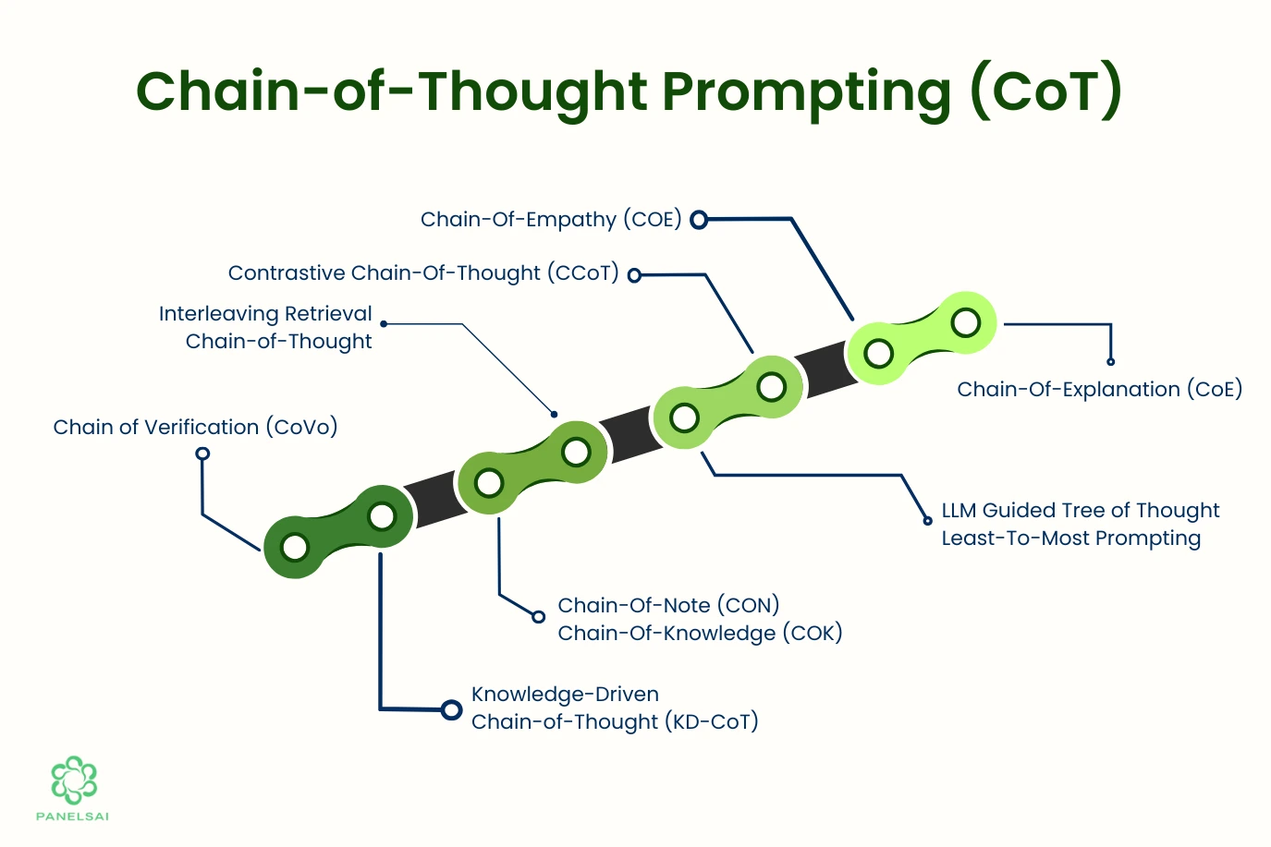
Apply Chain of Thought (CoT)
CoT enables step-by-step reasoning in LLMs, improving logical accuracy.
Example
Prompt: “What’s 12% of 250?” CoT Reasoning:
10% of 250 = 25
2% of 250 = 5
25 + 5 = 30 → Answer: 30

Slide 31
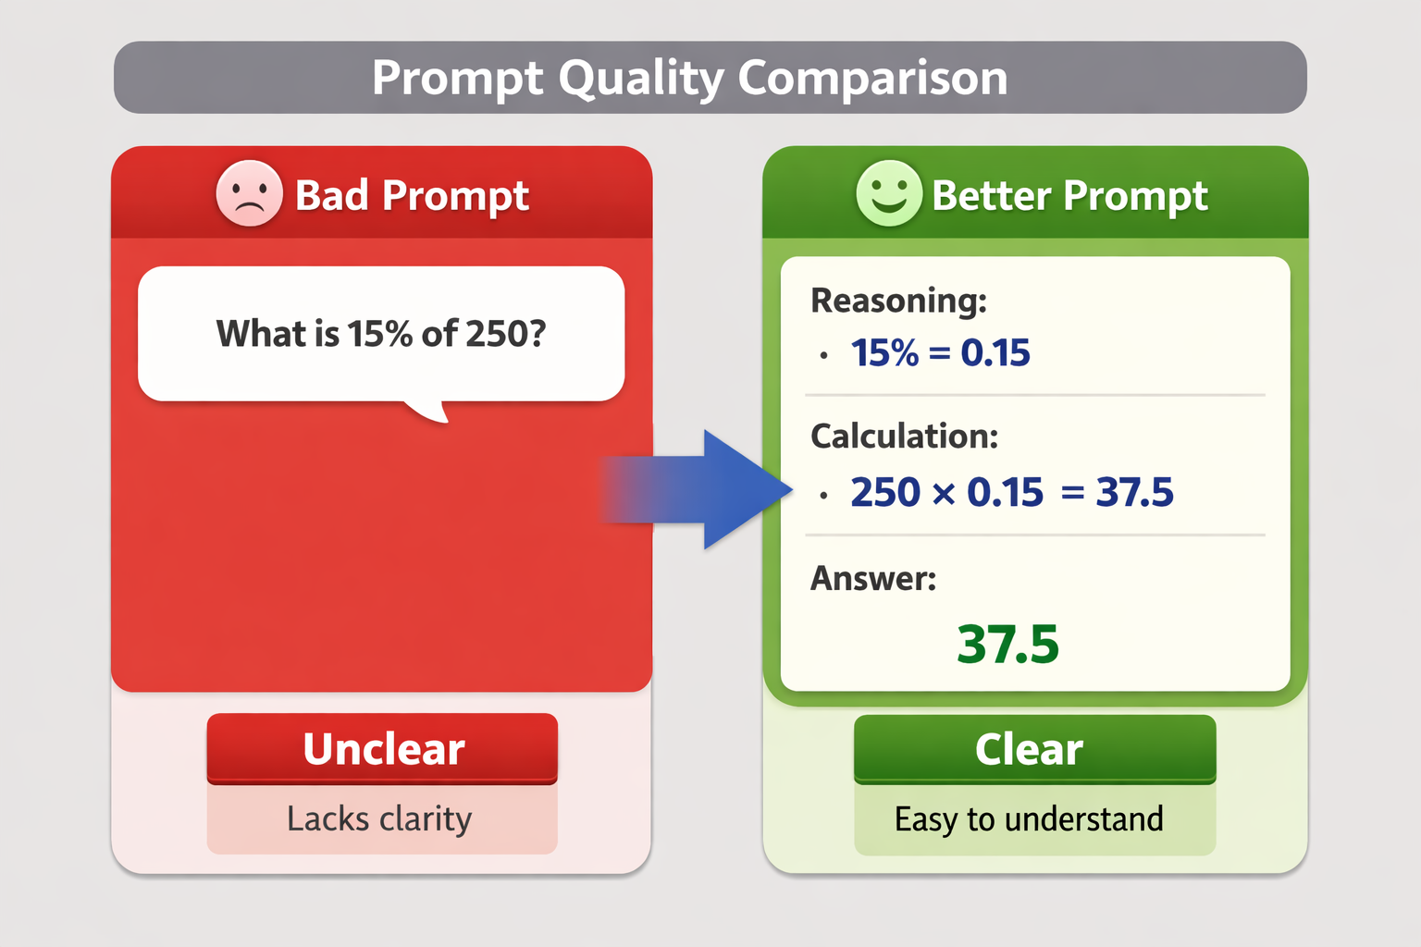
Example
Example:
Bad Prompt:
What is 15% of 250?
Better:
Calculate step by step.
Reasoning:
15% = 0.15 250 × 0.15 = 37.5
Answer: 37.5

Slide 32
Tree of Thoughts (ToT)
ToT generalizes CoT: instead of one chain, the model explores multiple reasoning branches, evaluates them, and keeps the most promising path.
CoT — single chain
ToT — branch, evaluate, prune
Step 1
Goal
Step 2
Idea A
Idea B
Idea C
Step 3
✗ pruned
✗ pruned
Best
Best
Answer
ToT trades more compute for better answers on problems with many possible approaches (planning, puzzles, search).

Slide 33
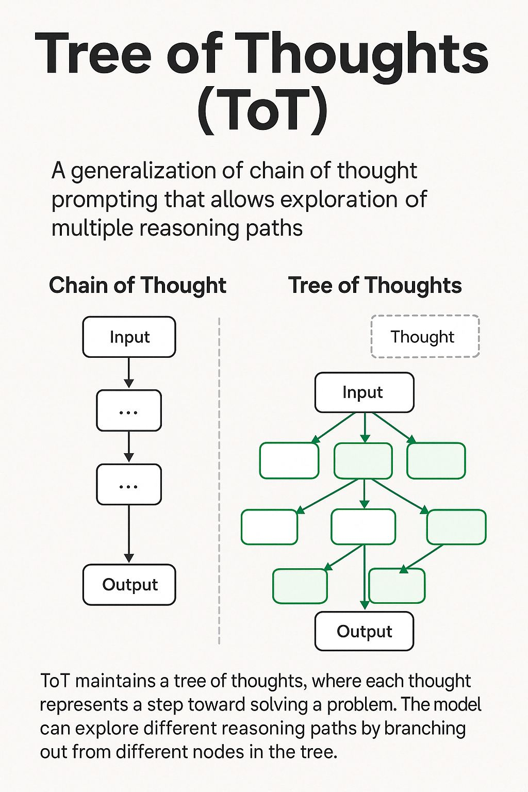

Slide 34
ToT Example
[ Launch a Startup ]
|
-------------------------------------------------
| | |
[ Path A ] [ Path B ] [ Path C ]
AI SaaS Consulting Marketplace
| | |
| | |
| | |
v v v
[ Revenue ] [ Revenue ] [ Revenue ]
[ Complexity ] [ Complexity ] [ Complexity ]
[ Risk ] [ Risk ] [ Risk ]
| | |
------------------- Evaluation ------------------
|
[ Best Option ]
Goal:
Launch a startup.
Path A:
AI SaaS
Path B:
Consulting
Path C:
Marketplace
Evaluate:
Revenue Complexity Risk
Select best option.

Slide 35
Building Custom Tools
A tool is a function the agent can call. Four parts let the LLM decide when and how to use it — the description and schema are what the model actually reads.
1 Name
Python · LangChain @tool
A short, unique identifier the model uses to call it (e.g. get_weather).
from langchain.tools import tool @tool def get_weather(city: str) -> str: """Get current weather for a city.""" data = api.fetch(city) return f"{data.temp}°C, {data.sky}" # the agent now sees: # name = get_weather # desc = Get current weather... # schema = { city: string }
2 Description
Plain-language purpose. The LLM reads this to decide when to use the tool.
3 Input schema
Typed parameters (JSON schema) so the model knows what arguments to pass.
4 Function
The actual code that runs and returns a result back to the agent.

Slide 36
OpenRouter APIs
OpenRouter is a single API gateway to hundreds of models (OpenAI, Anthropic, Qwen, Llama...). One key, one endpoint, OpenAI-compatible.
One API, many models
Your app / agent
Swap models by changing one string — no SDK rewrites.
OpenRouter gateway
OpenAI-compatible
Use the existing openai client; just change base_url and key.
OpenAI
Anthropic
Qwen / Llama
Unified billing
One account and key across all providers; transparent per-token pricing.
base_url = "https://openrouter.ai/api/v1" client = OpenAI(base_url=base_url, api_key=KEY) client.chat.completions.create( model="qwen/qwen-2.5-72b-instruct", ...)
Fallbacks & routing
Auto-route to backups on rate limits or outages for reliability.

Slide 37
Integrating Qwen Models
Qwen (Alibaba) is an open-weight model family with strong reasoning and native tool/function-calling — a solid, low-cost backbone for agents. Reach it through OpenRouter's OpenAI-compatible API.
Common variants
Strong function-calling
Reliably emits structured tool calls — ideal for executor agents.
qwen-2.5-72b-instruct
Flagship general + tool use
qwen-2.5-coder
Code & tool generation
Open weights
Self-host or use hosted; no vendor lock-in, transparent licensing.
qwq-32b
Reasoning-tuned (CoT/ToT)
LangChain + Qwen via OpenRouter
Long context
from langchain_openai import ChatOpenAI llm = ChatOpenAI( model="qwen/qwen-2.5-72b-instruct", base_url="https://openrouter.ai/api/v1", api_key=OPENROUTER_KEY, ) llm.invoke("Plan the next step...")
Handles large prompts, tool outputs and memory in one window.
Cost-effective
Competitive per-token pricing for high-volume agent loops.

Slide 38
Integration Steps
Obtain API key from OpenRouter or HuggingFace.
2. Configure endpoint in agent framework.
3.Test reasoning and tool-calling compatibility.

Slide 39
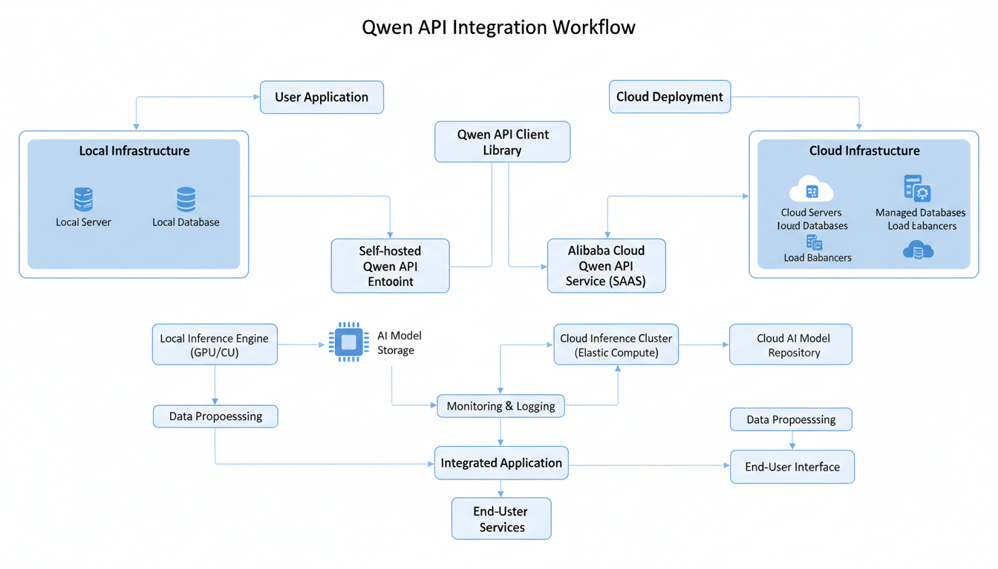

Slide 40
Function Calling
Function calling lets the model request a tool by emitting structured JSON instead of prose. Your code runs the function and returns the result, which the model uses to finish the answer.
1. User request
1 Tool definition (JSON schema)
“What’s the weather in Paris?”
{
"name": "get_weather",
"description": "Get current weather",
"parameters": {
"type": "object",
"properties": {
"city": {"type": "string"}
},
"required": ["city"]
}
}
2. Model emits tool_call
Returns JSON: name + arguments (no prose answer yet)
3. App executes function
Your code calls get_weather(“Paris”)
2 Model returns a tool_call
4. Result returned to model
"tool_calls": [{ "function": { "name": "get_weather", "arguments": "{\"city\": \"Paris\"}" } }]
Tool output appended to the message history
5. Model composes answer
“It’s 18°C and clear in Paris.”

Slide 41
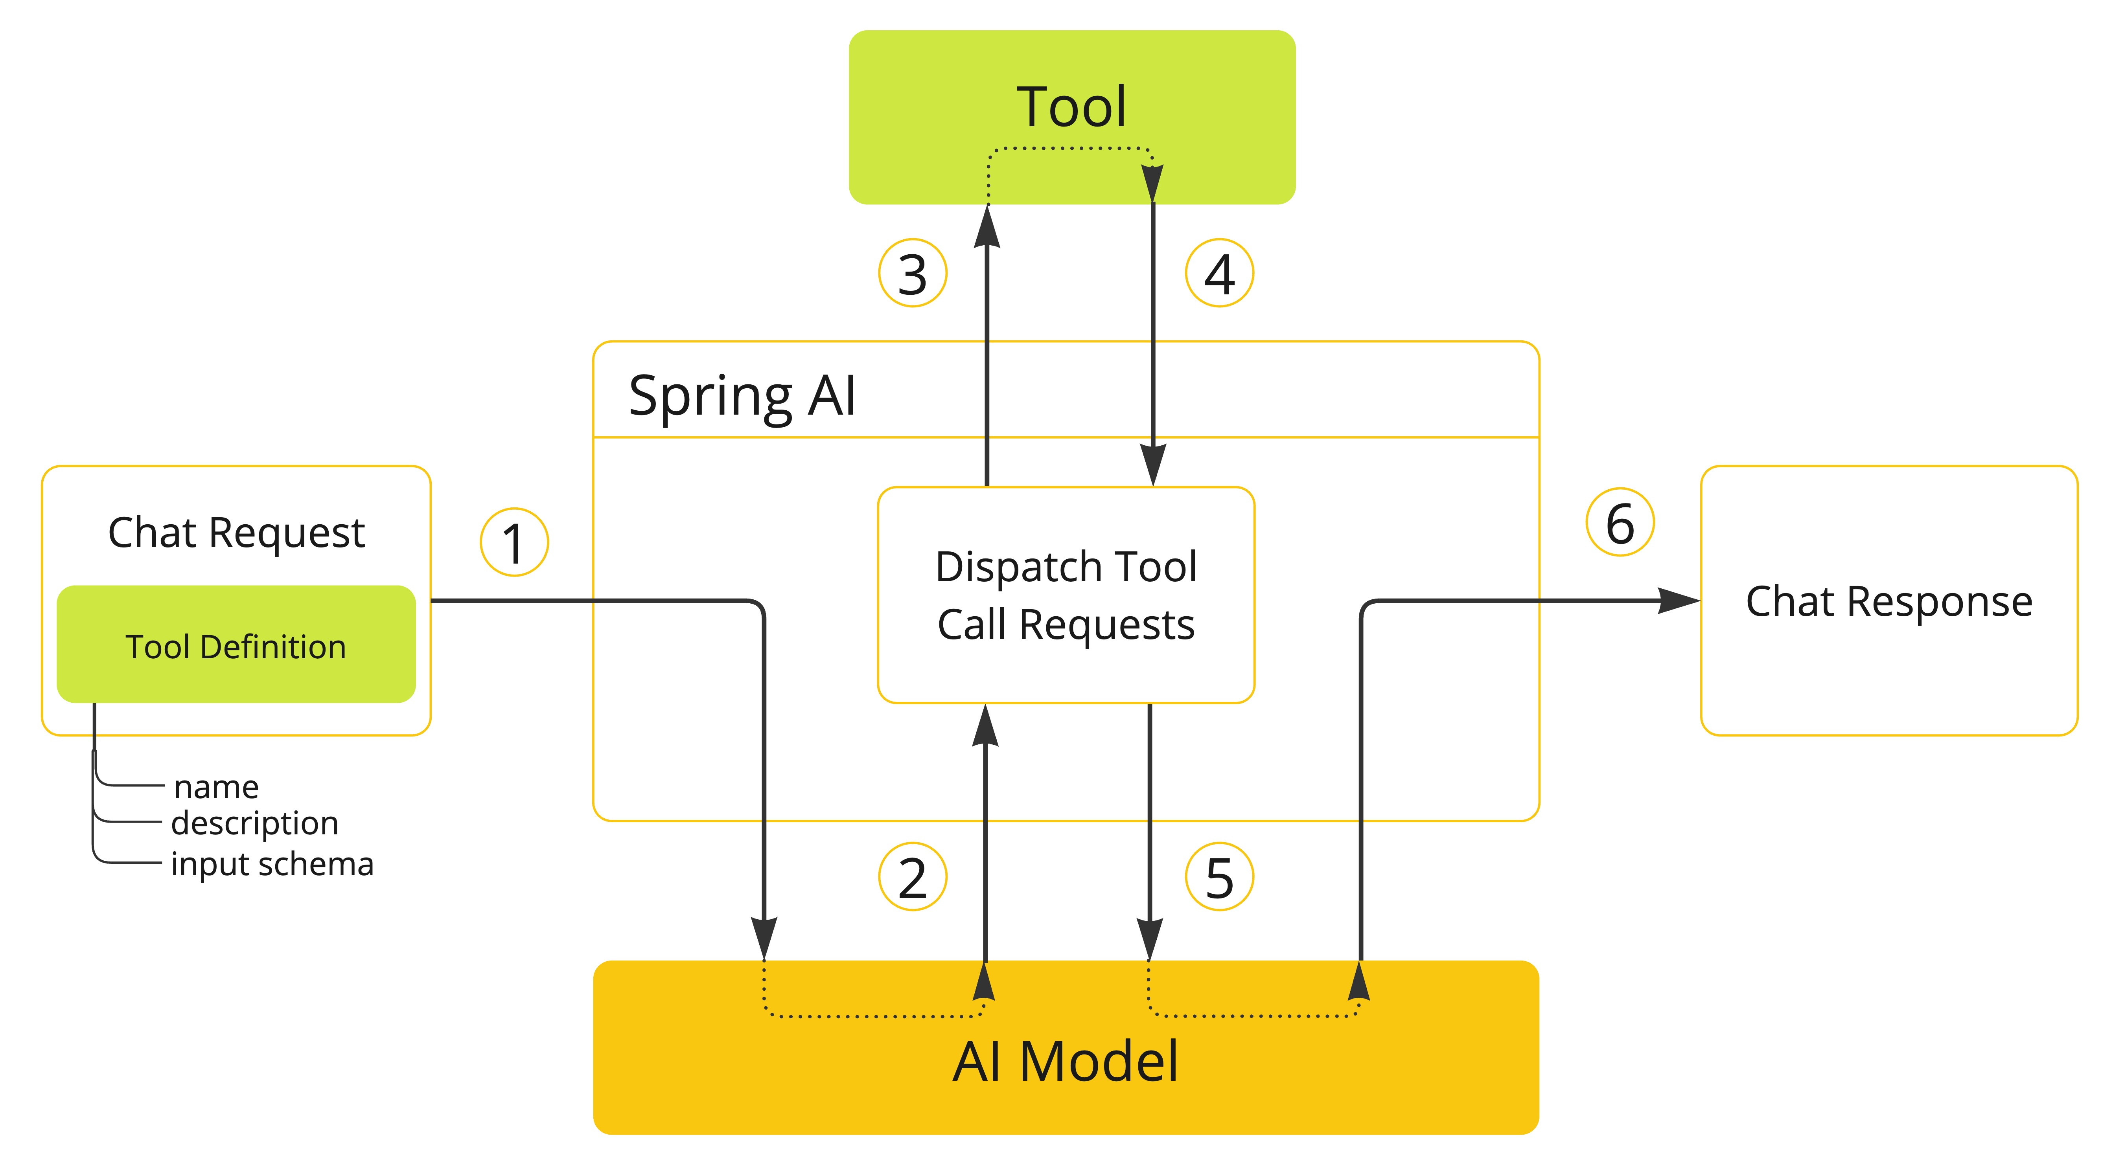

Slide 42
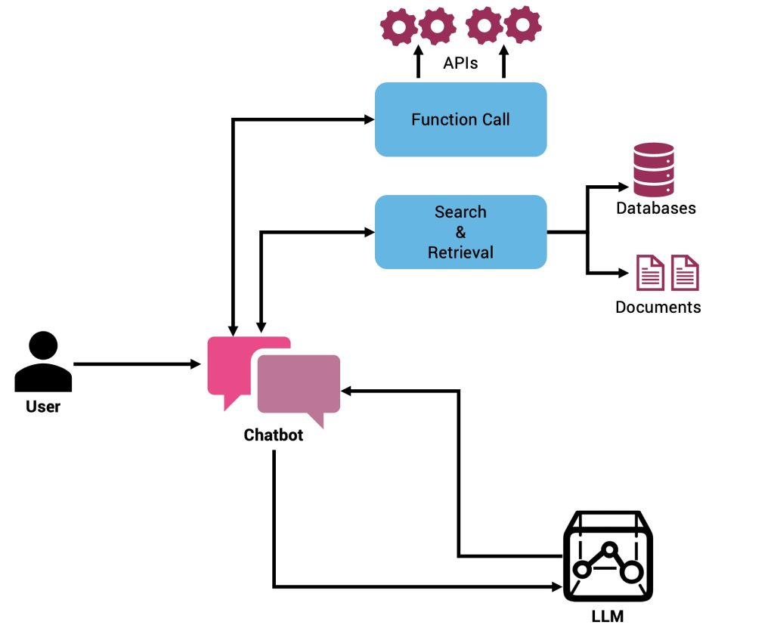

Slide 43
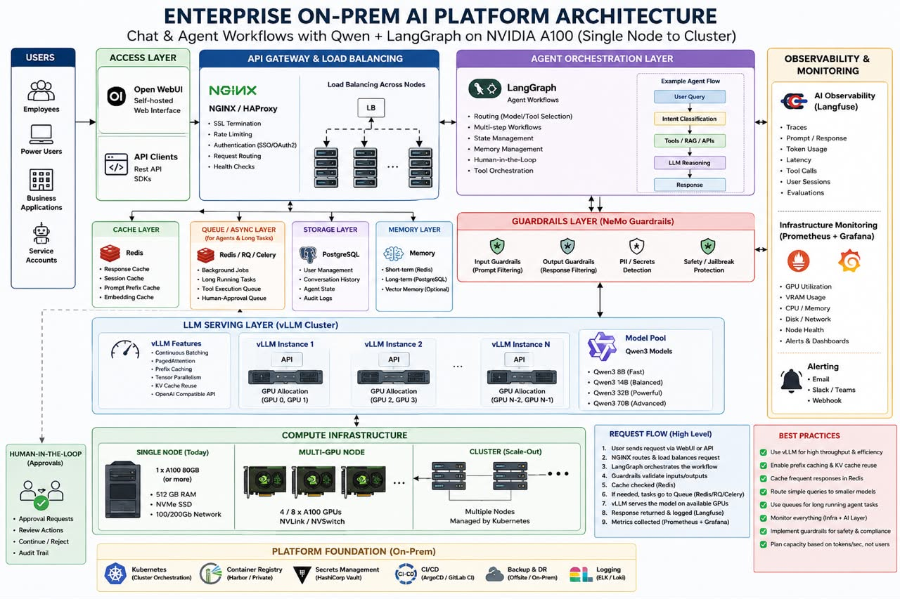

Slide 44
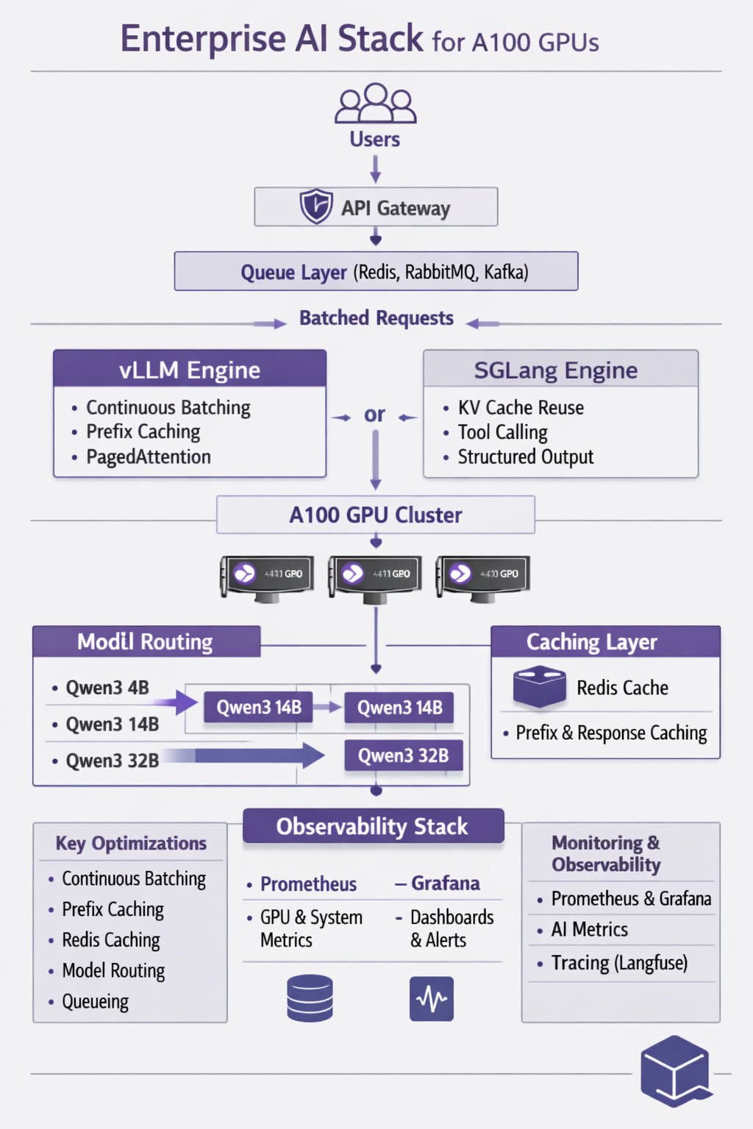

Slide 45
Building a Reasoning Agent with LangChain
LangChain wires an LLM, a set of tools, and an AgentExecutor into a ReAct loop — the model reasons, picks a tool, observes the result, and repeats until it produces a final answer.
1 LLM reasons (Thought)
agent.py
Decides what to do next based on the goal
from langchain.agents import \
create_react_agent, AgentExecutor
from langchain_openai import ChatOpenAI
from langchain import hub
llm = ChatOpenAI(
model="qwen/qwen-2.5-72b",
base_url=OPENROUTER_URL, api_key=KEY)
tools = [get_weather, search]
prompt = hub.pull("hwchase17/react")
agent = create_react_agent(llm, tools, prompt)
executor = AgentExecutor(agent=agent,
tools=tools)
executor.invoke({"input": question})
2 Selects an action (Tool)
Chooses a tool + arguments to call
3 AgentExecutor runs the tool
Executes the call, captures the output
4 Observation feeds back
Result returned to the LLM as context
loop until final answer
✓ Final answer returned to user

Slide 46
Architecture
Component | Role
LLMChain | Connects prompts and models.
Memory | Stores context across turns.
Tools | Executes external actions.
Agents | Orchestrates reasoning and tool use.

Slide 47
⚙️ Top 5 Local Agent Frameworks
Framework | Key Strength | Offline Compatibility
LangGraph | Graph-based orchestration, multi-agent loops, tool calling | ✅ Fully local
CrewAI | Multi-agent collaboration, simple YAML config | ✅ Local via Ollama
Autogen (Microsoft) | Multi-agent coordination, Pythonic design | ✅ Local with custom LLM endpoints
SmolAgents | Lightweight, minimal dependencies | ✅ Runs on local models
OpenDevin | Developer-focused autonomous agents | ✅ Local Docker setup

Slide 48
Top Observability Tools
Tool | Focus | Local Mode
Langfuse | Tracing, spans, metrics, token usage | ✅ Self-host via Docker
TruLens | Evaluation and feedback tracking | ✅ Local Python integration
Opik | Agent performance and dataset tracking | ✅ Local SQLite mode
OpenLLMetry | OpenTelemetry-based observability | ✅ 100% local
PostHog | Analytics and event tracking | ✅ Self-hosted option

Slide 49
Top Memory Managers
Tool | Type | Local Storage
LangChain Memory | Conversation + vector memory | ✅ Local JSON/SQLite
MemGPT | Hierarchical memory system | ✅ Local file-based
LlamaIndex | Document + vector memory | ✅ Local embeddings
ChromaDB | Vector store | ✅ Local persistent DB
FAISS | High-speed similarity search | ✅ Local binary index

Slide 50
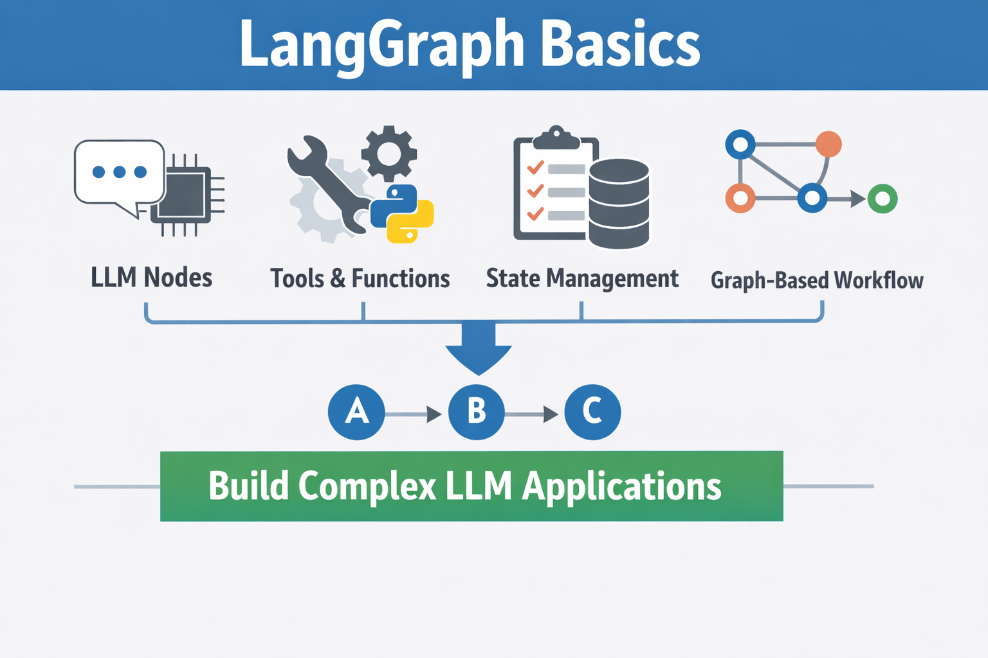

Slide 51
Langgraph
🗂️ State Management
LangGraph keeps track of conversation and workflow state.
It stores variables, user inputs, and intermediate results.
This ensures consistency and context retention across multiple steps or turns.
🔗 Graph-Based Workflow
The entire system is structured as a graph of connected nodes.
Each node passes data to the next, forming a directed flow.
This design makes it easy to visualize, debug, and scale complex
🧠 LLM Nodes
These are the core units that represent language model operations.
Each node handles a specific task, like generating text, summarizing, or answering questions.
You can connect multiple nodes to form a logical flow of AI reasoning.
🧰 Tools & Functions
This layer integrates external capabilities into your graph.
Tools can be APIs, Python functions, or database queries.
They extend the LLM’s power by letting it perform actions beyond text generation — for example, calling a weather API or running a calculation. LLM applications.

Slide 53
n8n Fundamentals
What is n8n?
Open-source workflow automation tool
Connect apps, APIs, and services
Visual, node-based workflow builder
Alternative to Zapier, Make (Integromat)
Self-hosted & cloud options

Slide 54
n8n Fundamentals
Key Concepts
Workflow = automated process
Node = individual task/action
Connection = flow between nodes
Execution = running the workflow
Data flows as JSON between nodes

Slide 55
n8n Fundamentals
Trigger Nodes
Start a workflow
Wait for an event or condition
Examples:
Webhook Trigger
Cron (scheduled trigger)
App triggers (e.g., Gmail, Slack)
Only one trigger is typically required

Slide 56
n8n Fundamentals
Action Nodes
Perform tasks after trigger
Examples:
Send email
Create database record
Call API
Can have multiple action steps

Slide 57
Day 1 Recap: From Concept to Working Agent
Ten objectives, four themes — the foundations you can now build on.
Foundations
Reasoning
Tools & models
Putting it together
1
2
3
4
Agentic AI architecture
Agents vs LLM pipelines
Planner, Executor & Tool agents
Chain of Thought (CoT)
Tree of Thoughts (ToT)
Build custom tools
OpenRouter APIs
Integrate Qwen models
Function calling
Reasoning-enabled agent
Built with LangChain (ReAct)
You can now explain how agents reason, plan, and act — and wire one up end-to-end.

Slide 58
Q & A
Usama Wahab Khan
Twitter : @usamawahabkhan
LinkedIn : Usamawahabkhan

Slide 59
Thank you ☺

